Slide 1
Doodle Jump
Stejara Dinulescu

Slide 2
Hand-drawn inputs

Slide 3
Digitally drawn inputs

Slide 4

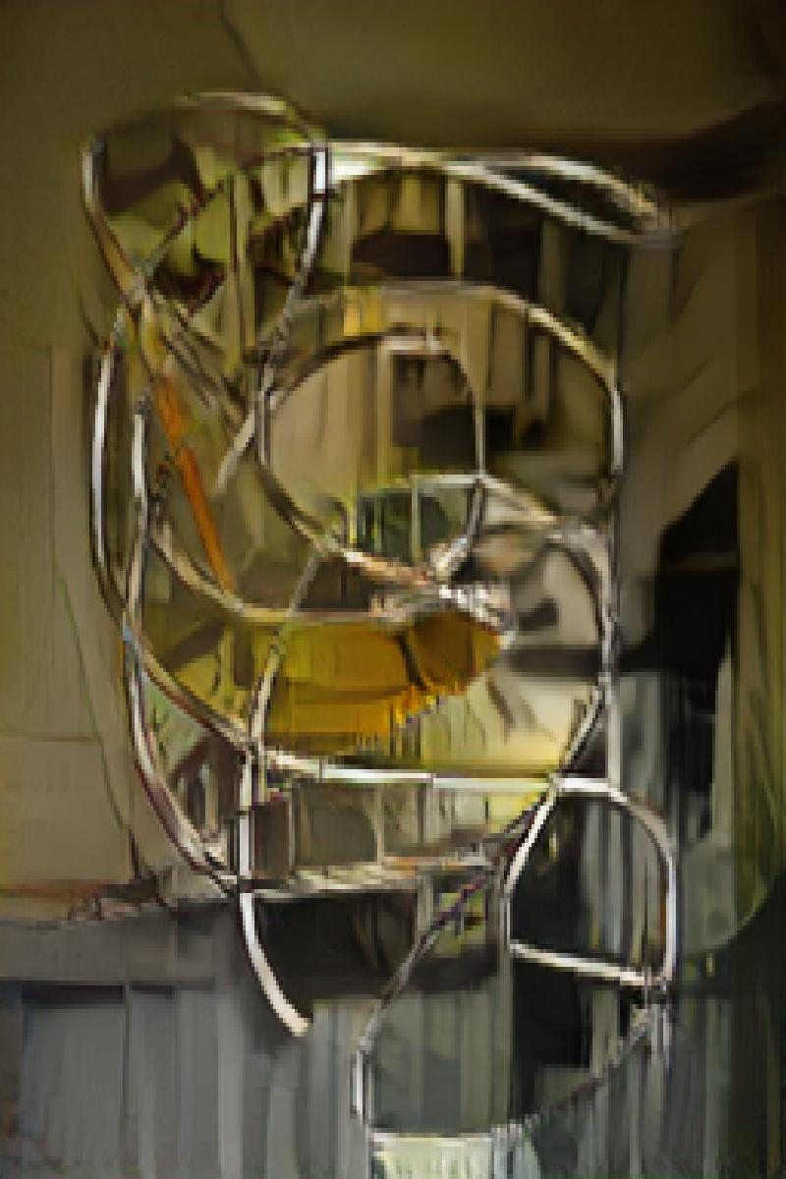
No pre-processing

Slide 5
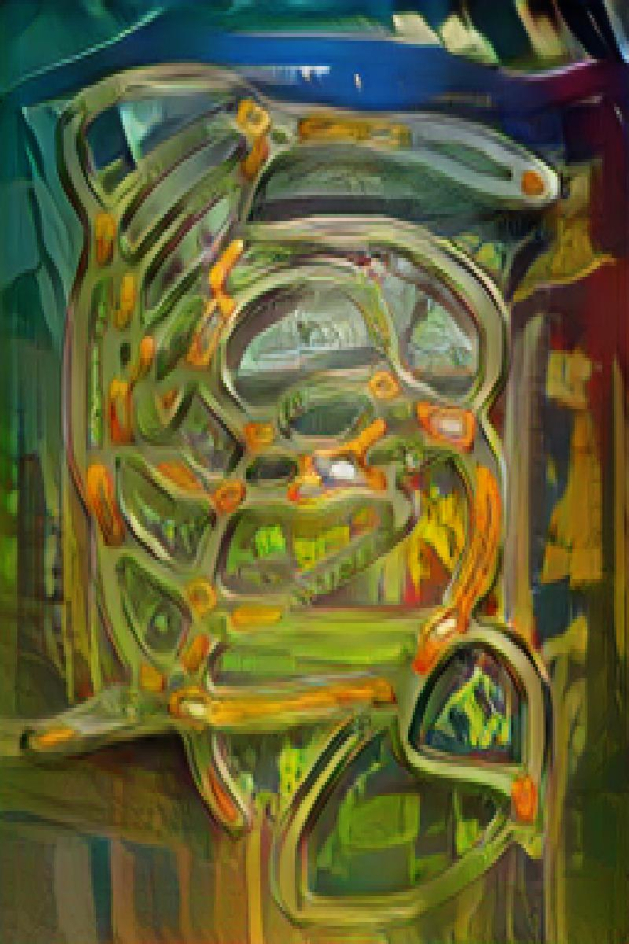
Gaussian blur pre-processing

Slide 6
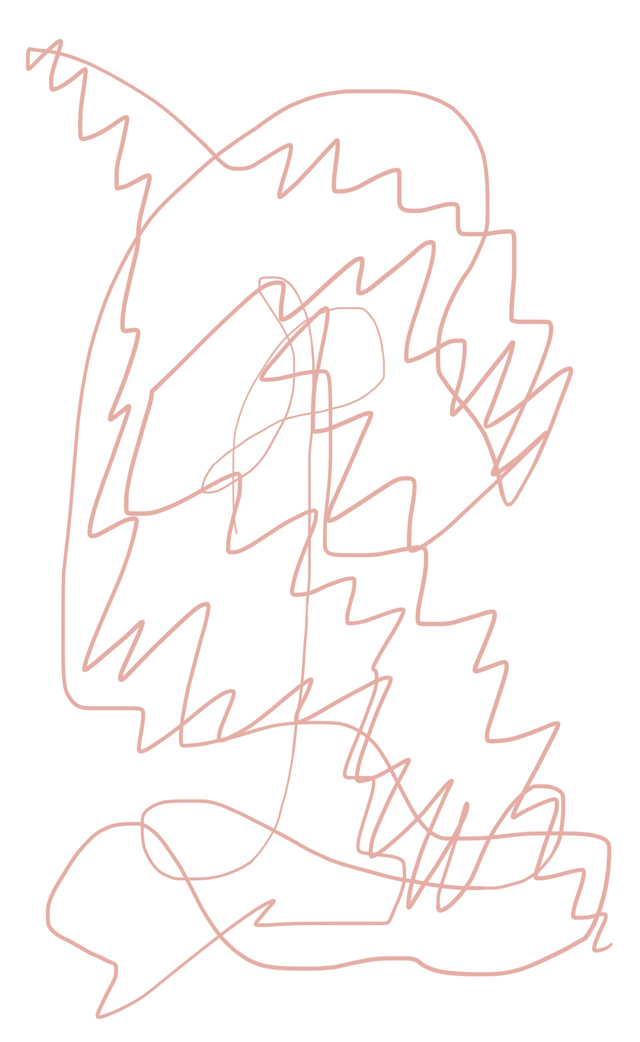
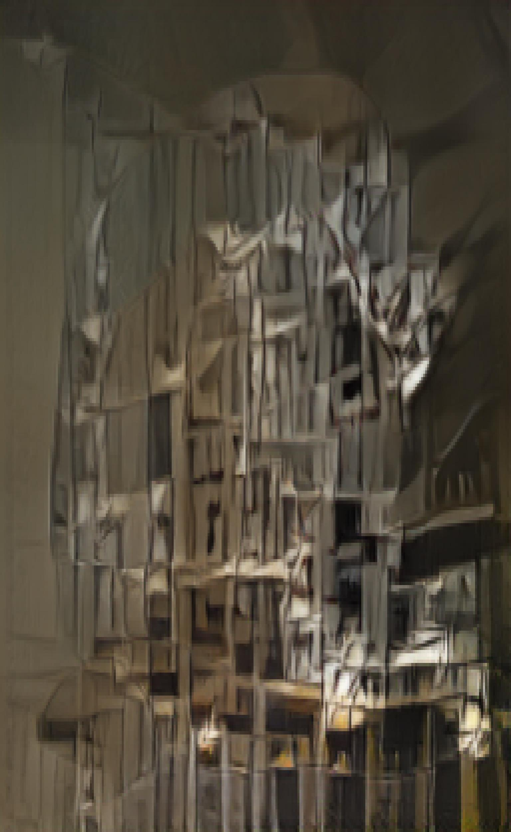
No pre-processing

Slide 7
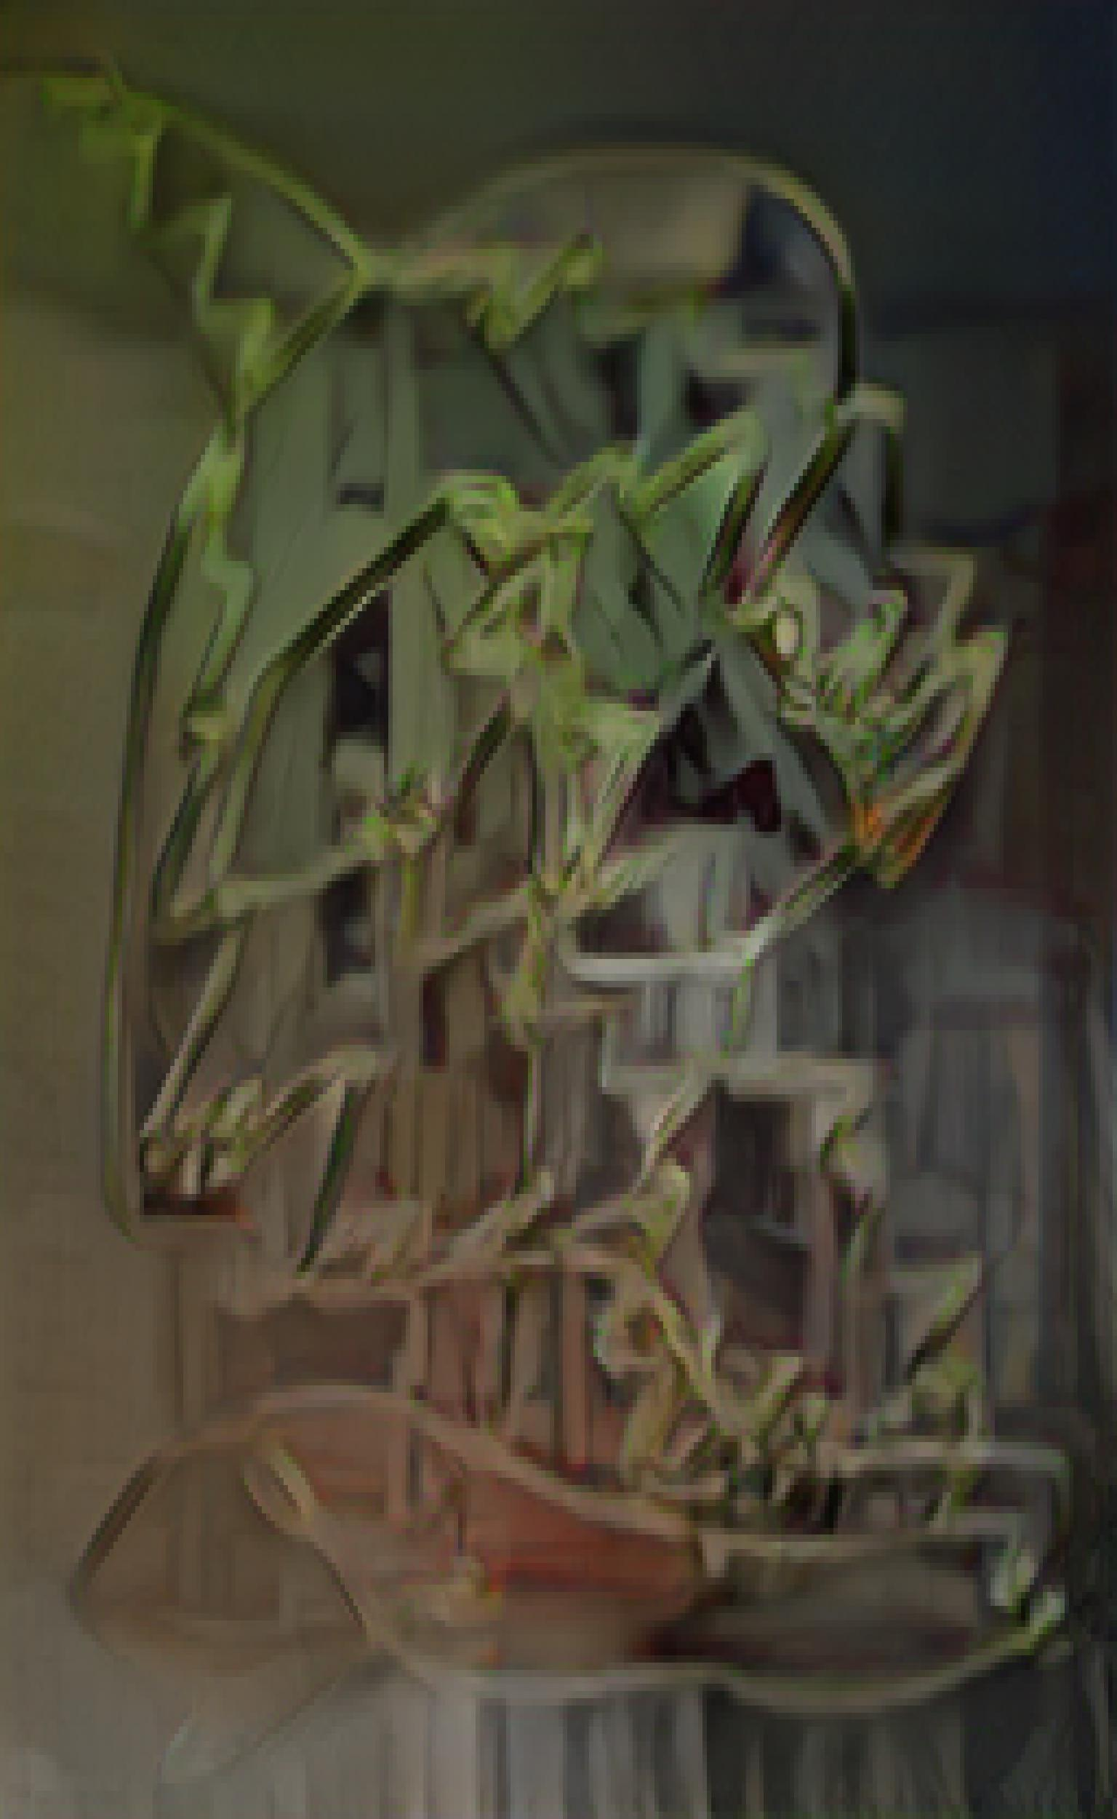
Gaussian blur pre-processing

Slide 8
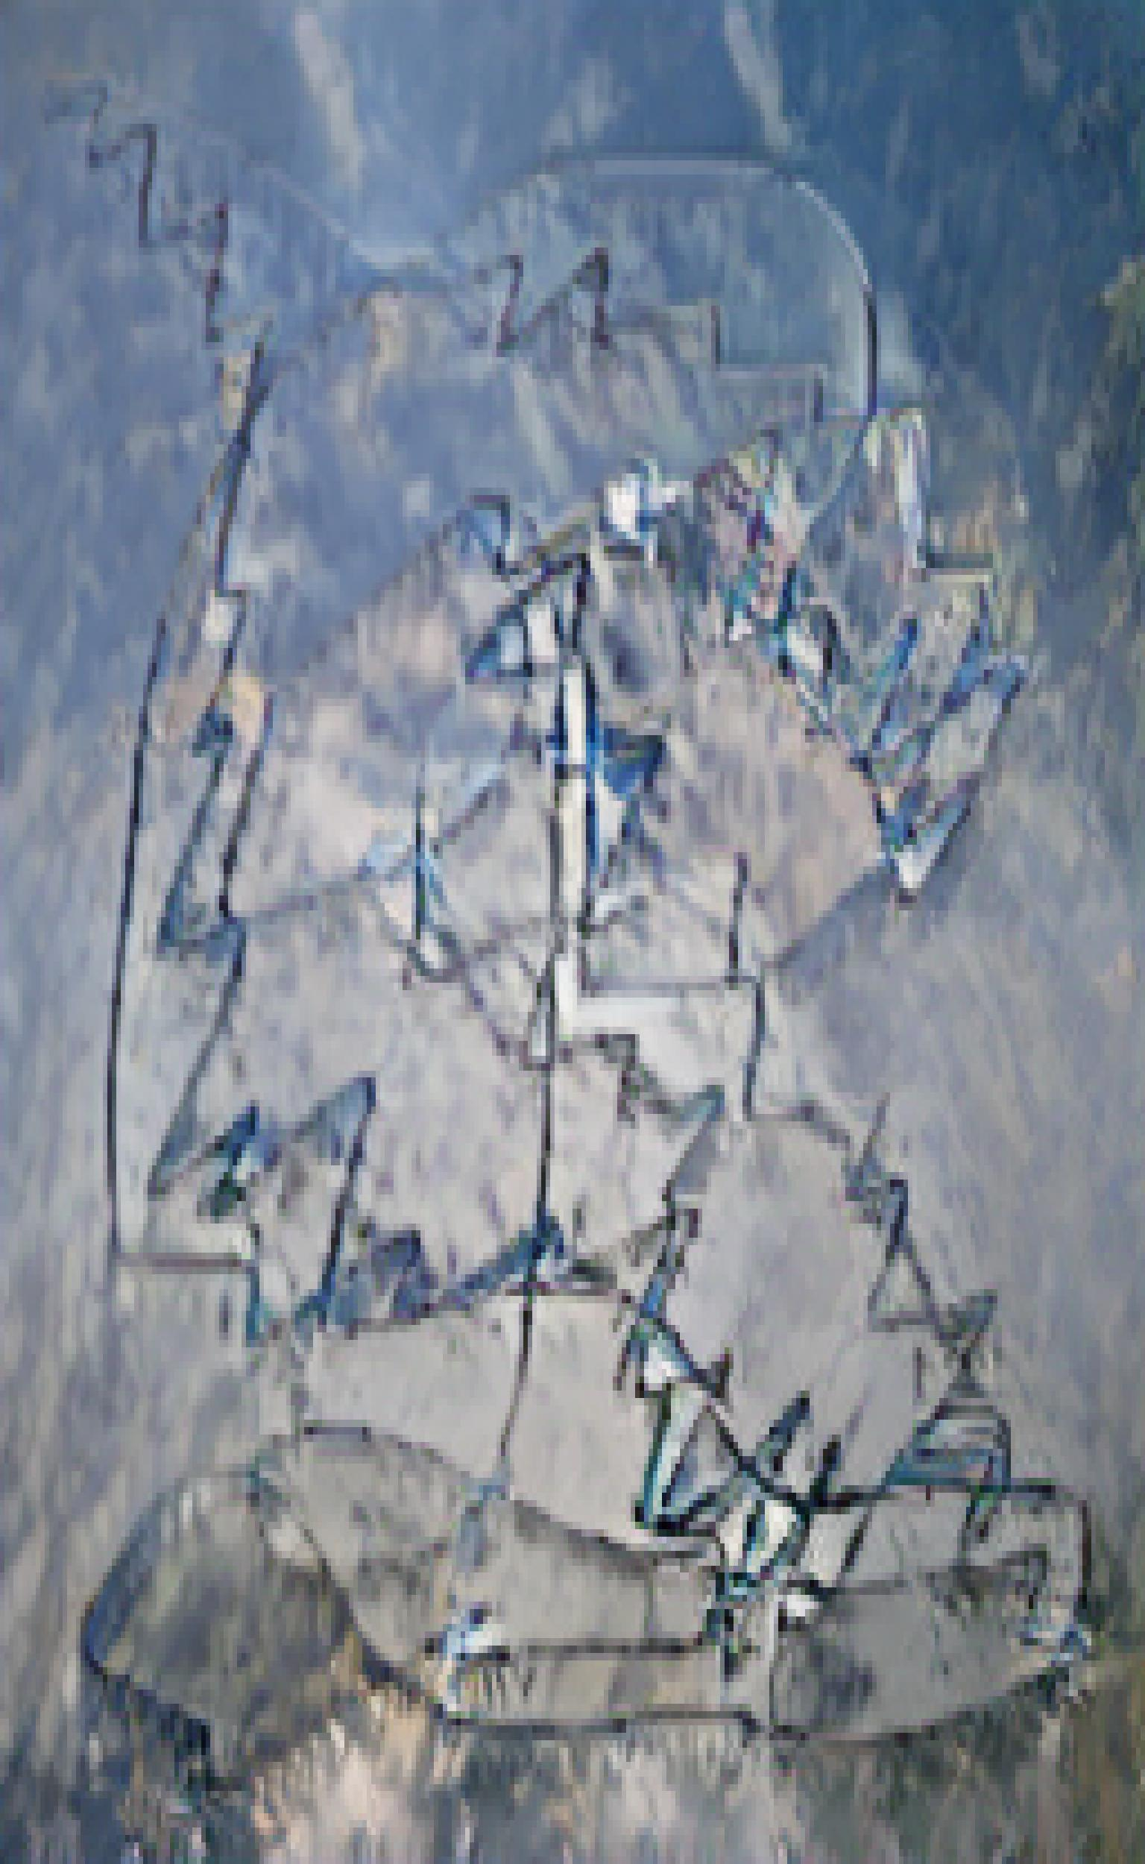
Invert pre-processing

Slide 9
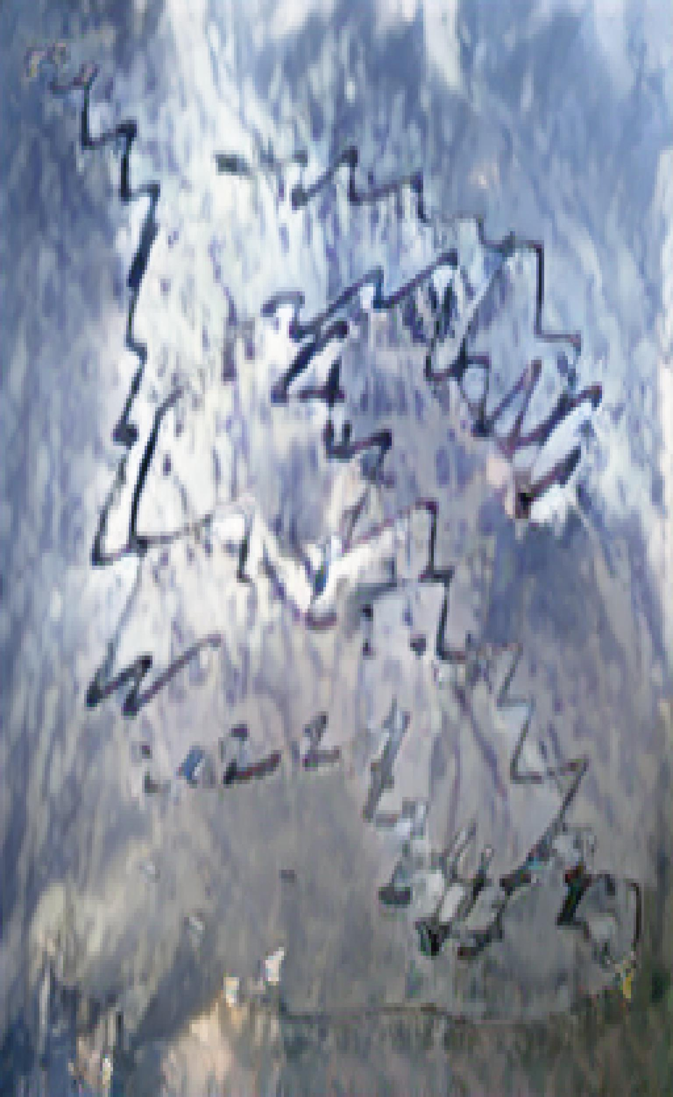

Invert + gaussian blur pre-processing

Slide 10
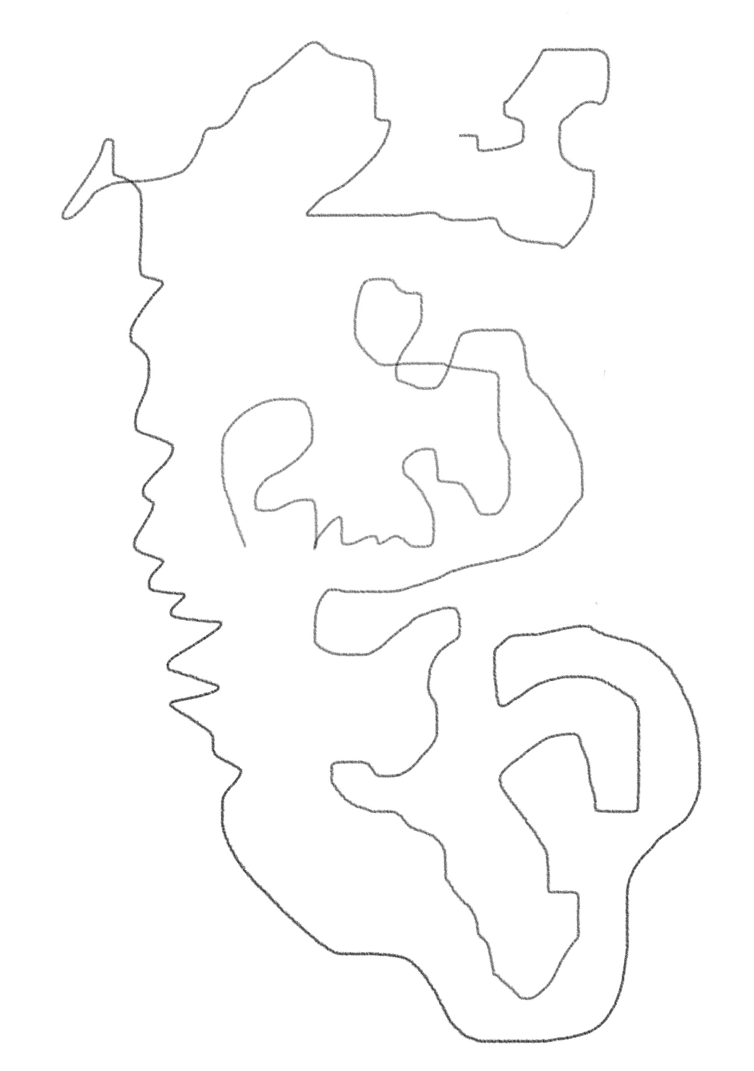
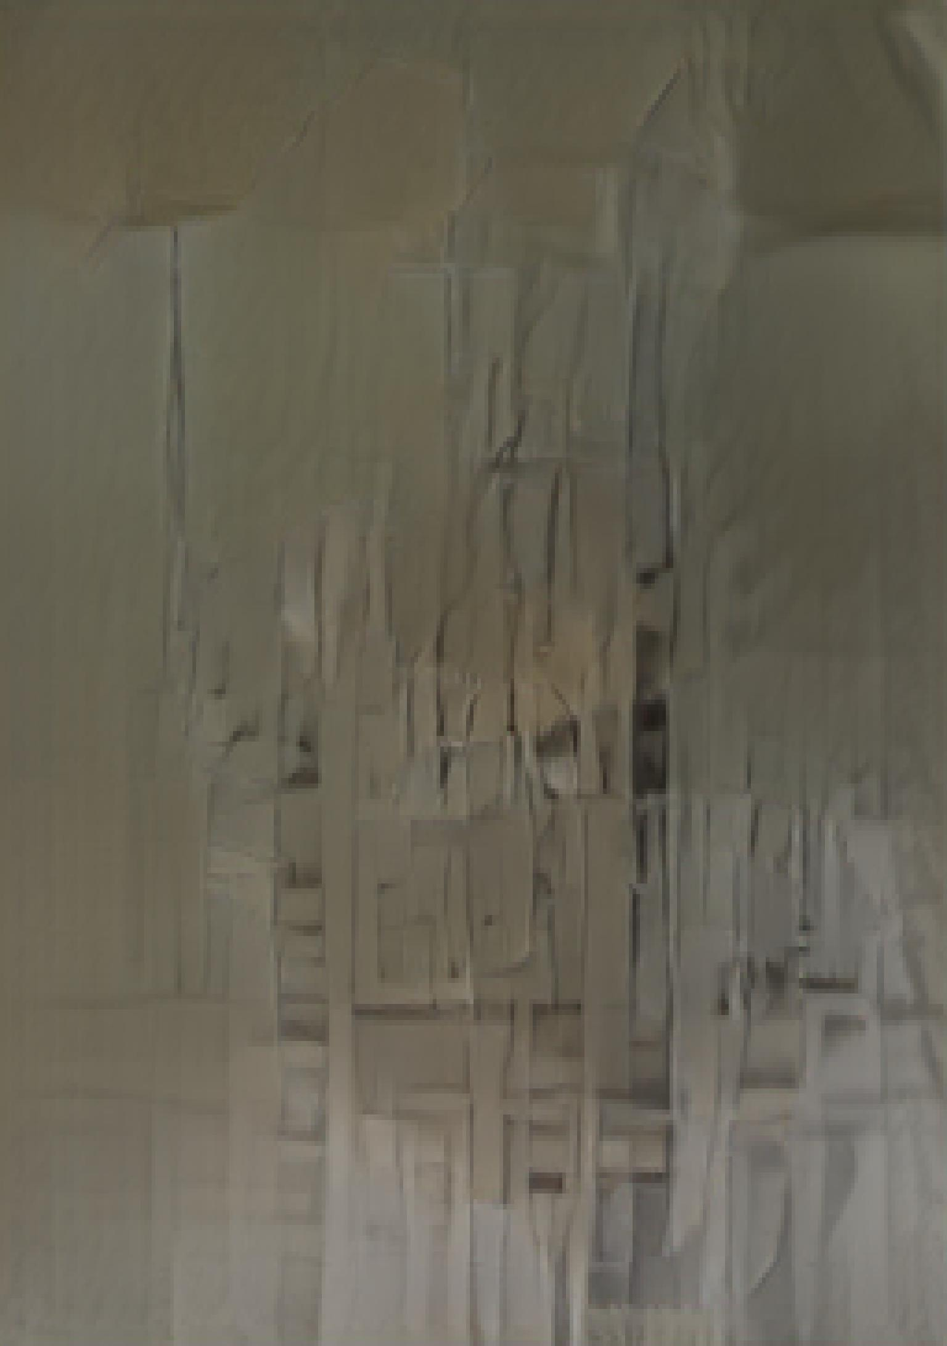
No pre-processing

Slide 11
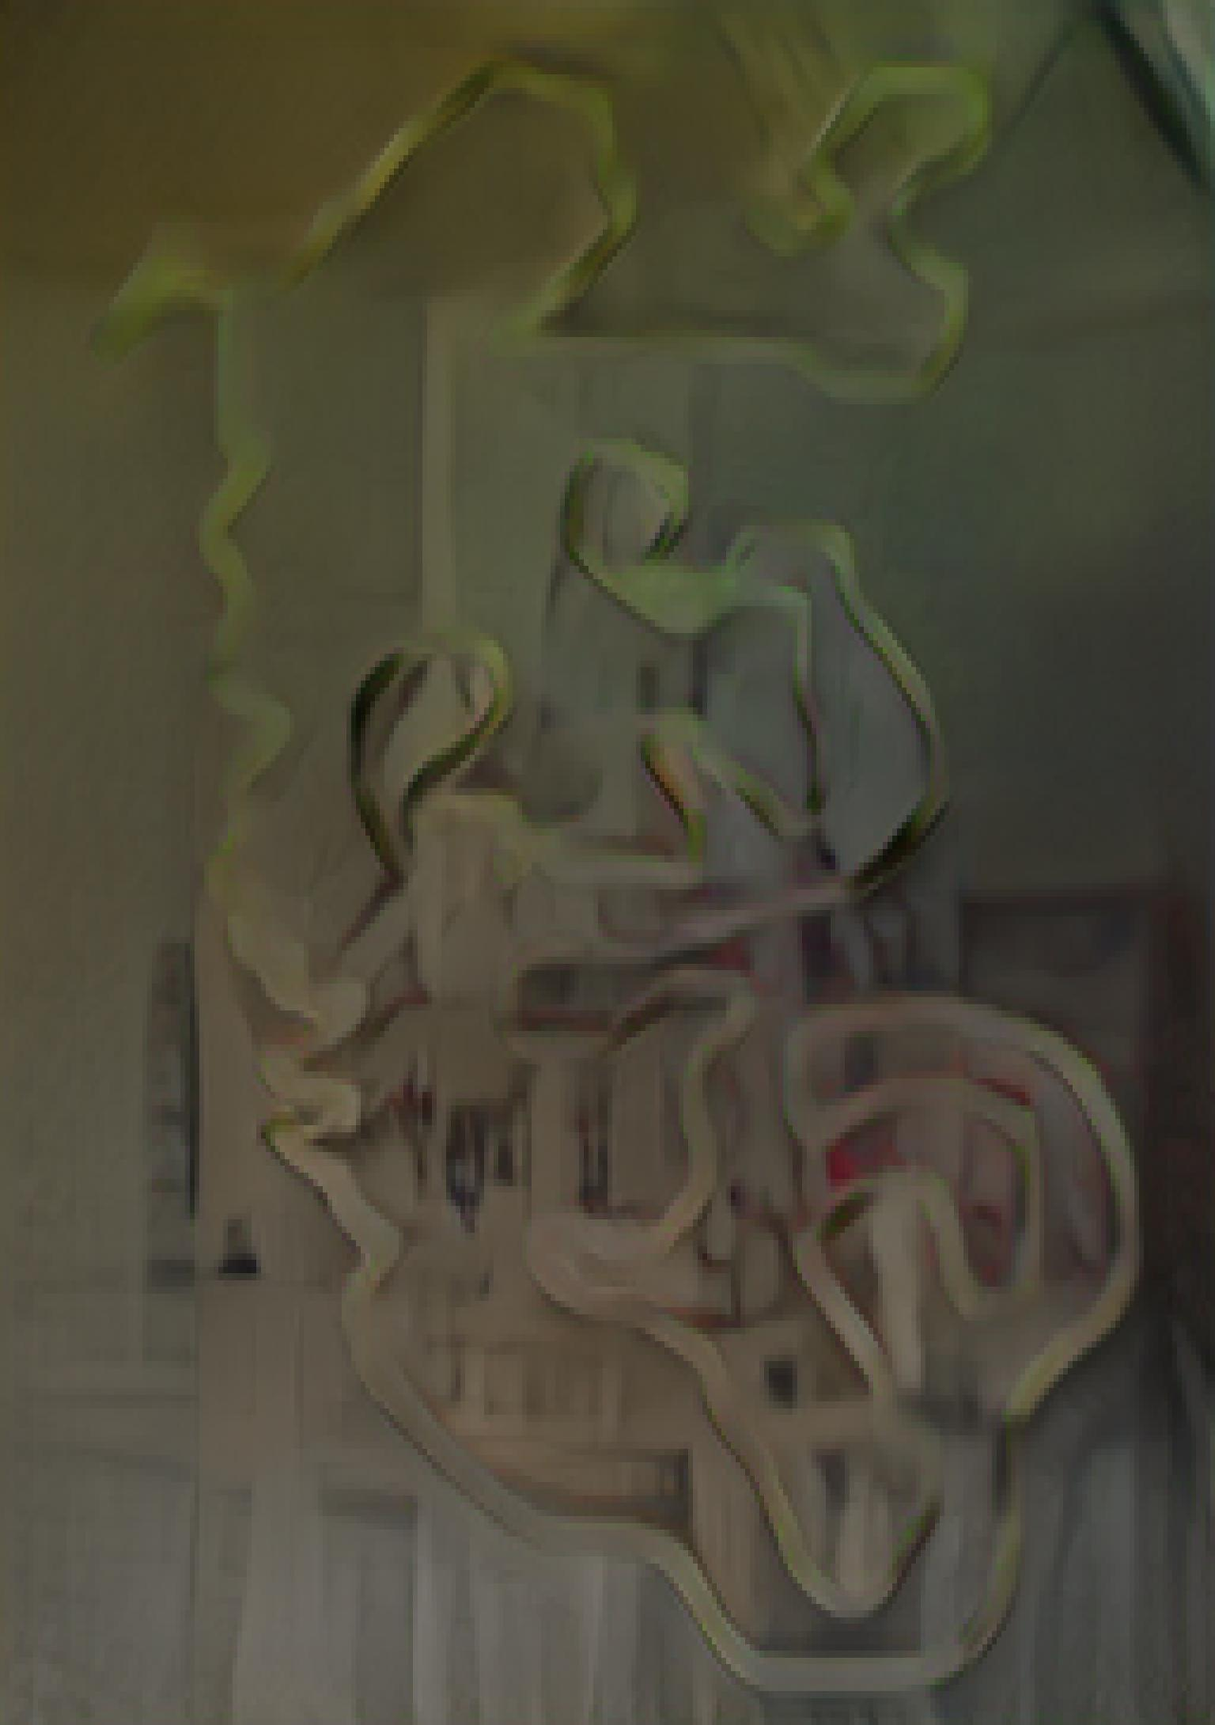
Gaussian blur pre-processing

Slide 12
Plotter inputs

Slide 13
Digitally coded inputs

